Slide 1
Pre-lab Questions(4 points each)

Slide 2
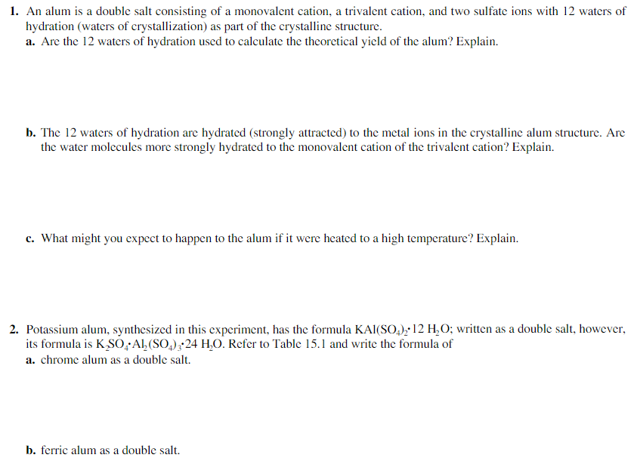

Slide 3
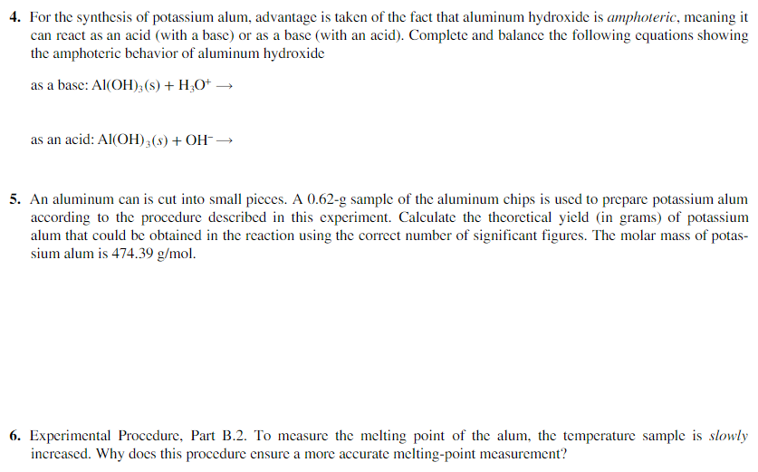

Slide 4
Laboratory Reports

Slide 5
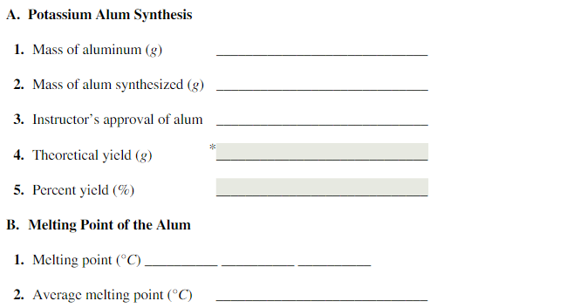
<- Figure shown in left is template for ‘(b) Result’ of Laboratory Reports.
Your ‘(c) Discussion’ must include the answer of these questions:
Show calculation of theoretical yield.
The melting point of potassium alum is 92.5°C. Comment on the purity of your sample based on your experimental melting point.

Slide 6
Post-lab Questions(2.5 points each)

Slide 7
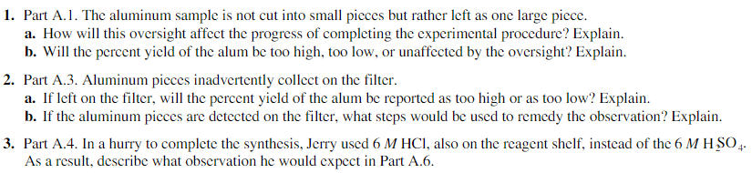
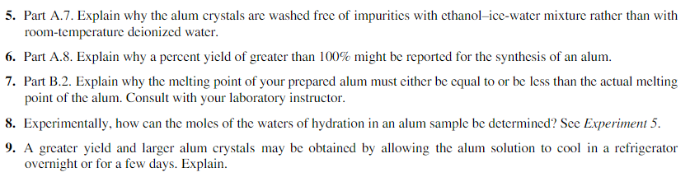
(#8, Experiment 5: ‘Percent Water in a Hydrated Salt’ <- google it!)

Slide 8
Textbook Content for Exp. 3

Slide 9
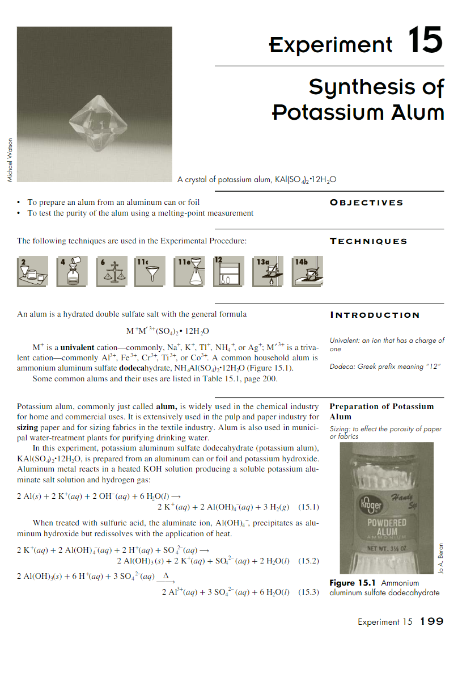
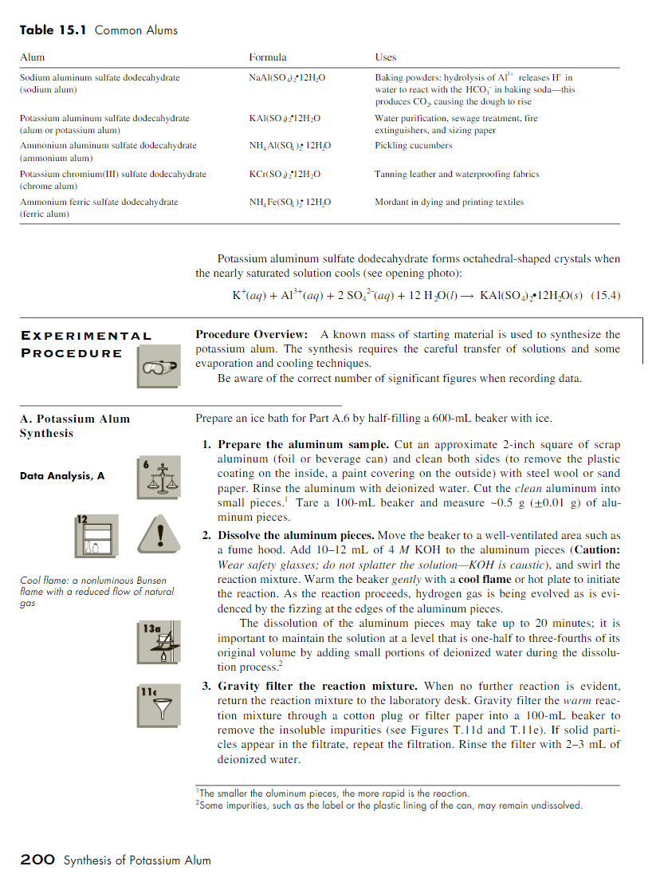

Slide 10
